Slide 1
Basic Webpage Design
Understanding Web
Technologies and Applications

Slide 2
Objectives
Explain how WWW works
Definition of terms
Understand the anatomy of a web address
Understand how a web page works

Slide 3
INTERNET BACKBONE - primary system of networks connecting both major network hubs and Internet users to the Internet itself.
  ARPANET (Advanced Research Projects Agency Network )
  – original backbone
  NSFNET (National Science Foundation Network)
  – the first high speed backbone in 1987
Notes:
Some of the largest companies running different parts of the Internet backbone include UUNET, AT&T, GTE Corp. and Sprint Nextel Corp. Their routers are connected with high-speed links and support different range options. Here in the Philippines PLDT

Slide 4
What is WWW (W3)?
It is often called as WEB that stands for the World Wide Web.
It is a network of computers all over the world.
All the computers use a communication standard called HTTP.

Slide 5
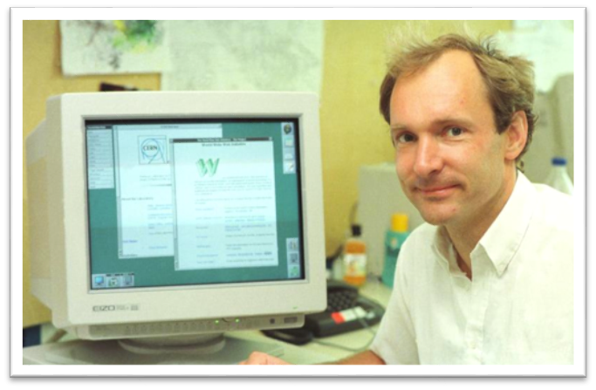
Who Developed the WWW?
Tim Berners-Lee developed World Wide Web in the late 1980’s and early 1990’s.

Slide 6
How Does WWW Works?
Role of Web Page
It is a document that serves as a storage of Web information.
Role of Web site
It is a collection of web pages linked or organized together having a common goal.
Role of Web Servers
A computer that serves as storage of the web pages or the web site

Slide 7
How Does WWW Works?
Role of Web Clients
These are the computers reading the web pages.
Role of Web Browsers
This is where web clients view the web pages.
Role of URL
Uniform Resource Locator. This is what the users or viewers submits request through an address bar of the web browser.

Slide 8
How Does WWW Works?
Role of HTML
The receiver and the interpreter of the requested instructions through Web browser.

Slide 9
WEB SERVERS
A software and hardware program that serves web pages to requesting clients.
It is used to host web sites.
PRODUCT | VENDOR
Apache | Apache
IIS (Internet Information Server) | Microsoft
nginx | NGINX, Inc.
GWS (Google Web Server) | Google

Slide 10
WEB BROWSER
A program that is used to view HTML documents.
Browser | Description
Internet Explorer | A free web browser from Microsoft which was released in 1995.
Mozilla Firefox | A free, open-source web browser from Mozilla available for Windows, Mac OS X, Linux, and Android.
Google Chrome | A free, open-source web browser developed by Google. It was released in 2008
Safari | In 2003, Apple developed their own browser in April 2005, Safari became the default browser for Mac systems.
Opera | A free, and it is the smallest and fastest browser.

Slide 11






GOOGLE CHROME
INTERNET EXPLORER
MOZILLA FIREFOX
OPERA
SAFARI

Slide 12
Understanding Web
Technologies and Applications
One way to think of the Internet is to picture it as a wide-area network that spans multiple geographic locations. Each location in this enormous network is made up of a group of computers that are relatively close in proximity to one another and are connected by hardware and cabling.

Slide 13
Understanding Web
Technologies and Applications
All types of computers are connected to the Internet. Most major colleges and universities, as well as many large companies, have connections right into what’s called the Internet backbone, the worldwide series of major junction points that ties the whole thing together.

Slide 14
Understanding Web
Technologies and Applications
The computers of people are connected to the Internet through the Internet Service Provider (ISP). Your ISP may be connected to another, bigger ISP, or possibly directly to the backbone.

Slide 15
Understanding Web
Technologies and Applications
Users communicate from one location to another using a communication protocol known as IP (Internet Protocol). This protocol, running on each computer connected to the Internet, ensures that communication breakdowns do not occur and that the networked computers can communicate and exchange data properly with one another.

Slide 16
Understanding Web
Technologies and Applications
Every computer connected to the Internet has a unique IP address. If duplicate IP addresses existed, information using a given address could end up in the wrong place. Software applications that run on the Internet are known as Internet Applications.

Slide 17
Understanding Web
Technologies and Applications
INTRANET APPLICATIONS
An intranet is a private local area network (LAN) or wide area network (WAN) that lets you use and interact with your Internet-based applications in a secure environment. An intranet application is an application that works on a private (network). It differs from an Internet application only in who can access it and the location of the client computer accessing it.

Slide 18
Understanding Web
Technologies and Applications
URLs
Every piece of information on the World Wide
Web has a unique address. This address is
called a Uniform Resource Locator, or URL.
URL is a pointer to some bit of data on the
web.

Slide 19
Understanding Web
Technologies and Applications
URLs
Example
How to get the information (what protocol to use: FTP, HTTP, and so on)
The Internet host name to contact (for example,
http://www.macromedia.com; http://localhost/mysite; or
ftp.mysite.com)
* The directory or other location in which to
find the requested information.

Slide 20
Understanding Web
Technologies and Applications
ANATOMY OF A WEB ADDRESS
The technical name for a web address is
Uniform Resource Locator, or URL. Here’s
what a URL looks like:
http://www.iskulnet.com/members/signup.html

Slide 21
Understanding Web
Technologies and Applications
http://www.iskulnet.com/members/signup.html
The http stands for Hypertext Transfer
Protocol, which is the standard method used
to transport Web pages over the Internet.

Slide 22
Understanding Web
Technologies and Applications
http://www.iskulnet.com/members/signup.html
This part of the address is called the domain name. You can own a domain name
by registering it through ISP’s or companies
recognized by InterNIC. You need to pay for
the domain name on a yearly basis, have it
parked or hosted by a Web Hosting
company.

Slide 23
Understanding Web
Technologies and Applications
http://www.iskulnet.com/members/signup.html
This is a subdirectory or subfolder within
your website. You can create as many
subdirectories to organize your web
contents. Note the forward slash (/) is used
to separate the protocol, domain name,
subdirectories and HTML file name not the
backward (\) used in Windows.

Slide 24
Understanding Web
Technologies and Applications
http://www.iskulnet.com/members/signup.html
This is the web document or HTML filename.
The file extension can either be .htm or
.html.

Slide 25
Summary
Every computer connected to the Internet has a unique IP address. If duplicate IP addresses
existed, information using a given address
could end up in the wrong place.
A web browser is a software program residing
on a computer that you use to view pages on
and navigate the World Wide Web

Slide 26

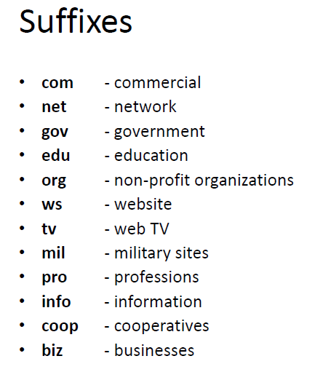

http://www.computerhope.com/jargon/num/domains.htm

Slide 27
What is a Static Web Site?
It is the simplest kind of web site you can build. Static web sites are written in HTML and CSS only, with no scripting. The only form of interactivity on a static web site is hyperlinks.

Slide 28
What is a Dynamic Web Site?
It is a web site that not only uses HTML and CSS, but includes web site scripting as well. For a dynamic site here are some of the scripting languages and frameworks that will be added to the code are JavaScript, PHP, Ruby on Rails and ASP.NET.

Slide 29
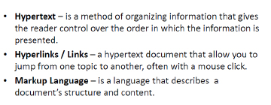
Review on Important Concepts
Web Server vs. Web Clients
Web Page vs. Website
Web Browsers

Slide 30
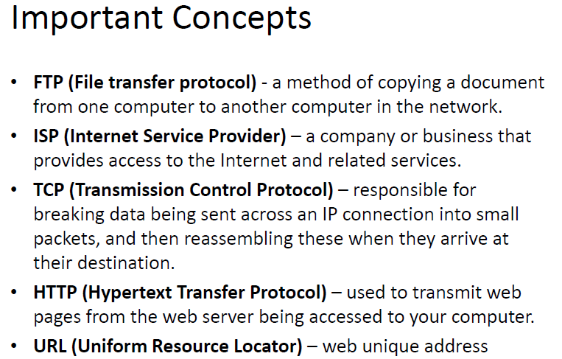

Slide 31
Planning a Website

Slide 32
Before beginning to build web site you should:
Identify your target audience
Have a statement of purpose
Know your main objectives
Have a concise outline of the information your site will contain.
Notes:
It is very important to plan for everything that you do.
Target Audience:What interests your target audience? How do you communicate with them effectively?
Purpose: To sell, to be famous, to interact with other web users
Main Objectives: advertisement, to gain profit
Outline: how are you going to organize the content of the website

Slide 33

Web site structure should meet the needs and expectations of the user.
Notes:
In order to create good content, you need to understand who your target audience.
When Apple made their iPod, they defined their target audience as non-tech savvy.

Slide 34
TYPES OF USERS
Web Surfers - they are the casual user that needs to be enticed with strong graphic content and bold statement of content.
Novice and Occasional Users - they depend on clear structure and easy access to web site.
Expert and Frequent Users - they depend on site to obtain information quickly and accurately.
International Users - they are users who could be in many different places.

Slide 35

Do not assume that all readers understands the developers conventions.
Example:
Reading Dates
Writing “3/4/97” – American would read it as March 4, 1997, other countries read it as April 3, 1997

Slide 36
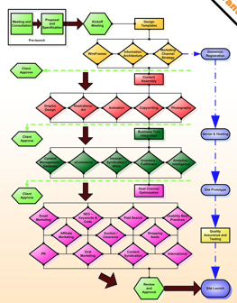
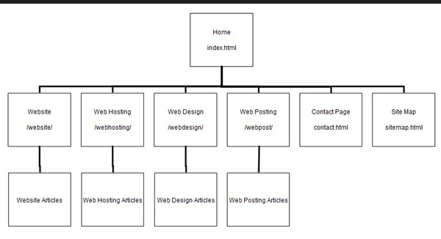
Steps to follow in planning a website:
• Getting Web Content
• Storyboarding
• Flowcharting
Sample Storyboard
Sample Flowchart
Notes:
Lets summarize to fully understant the steps to follow in planning a website

Slide 37
Information Architecture
Without Structure there is no Architecture - user should be able to comprehend to what the site is all about.
Reduction is Construction- learn how to consolidate similar topics to produce good site
Notes:
One. By defining the objective and purpose it is easier to have a structure of the website
Two: If it could be present in one topic then combine, google map location and contact details could be in one navigation.

Slide 38
Information Architecture
Navigation in the Information- use a clear and consistent global, parallel and local navigation.
a. Global Navigation – user can move between main sections, it should be present on every page.
b. Parallel Navigation – the presence of subcategories or subsections on each section which must be present on every page within section.
c. Local Navigation – works like table of contents
Notes:
The way to access your website is also very important

Slide 39
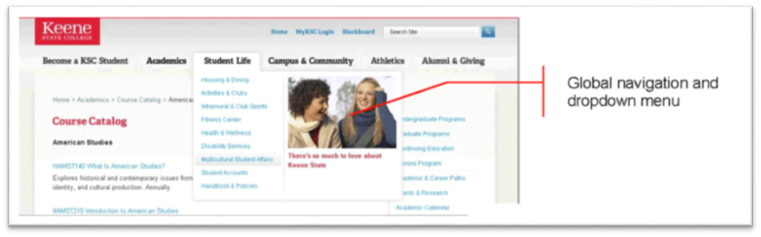
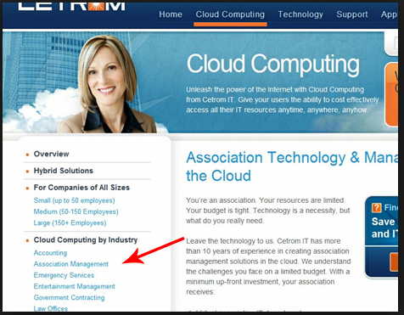
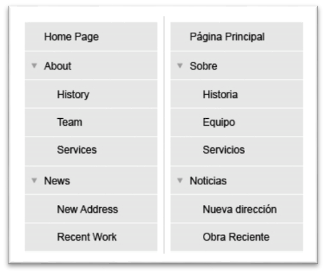
Global
Local
Parallel

Slide 40
Information Architecture
Common Architecture Mistakes
    Too many categories – “There should be no more that seven categories if possible.”
    Getting trapped in established structure – does the existing company’s department structure logical from viewers point of view.
Notes:
B a good example is a website that teach a savy user to be a programmer. For us programmer we are most comfortable to just write everything in codes but your target audience for tutorials may not be able to understand it.

Slide 41
Information Architecture
Common Architecture Mistakes
    Inconsistent Navigational Organization - concept should be simple and straightforward
    Burying Information in too many levels - Four hierarchical levels is too complex
Notes:
Currently, the trend of website are more on intelligent construction more on images and few text.

Slide 42
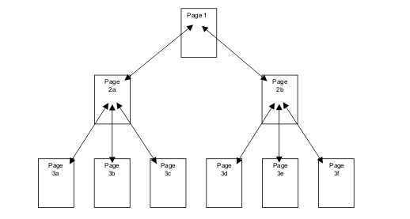
Hierarchical Organization
Notes:
Currently, the trend of website are more on intelligent construction more on images and few text.

Slide 43
Quality Web Design
Factors of Quality Web Design
• Content
• Accessibility
• Layout and Navigation
Notes:
Web content is the textual, visual or aural content that is encountered as part of the user experience on websites.
Web accessibility refers to the inclusive practice of making websites usable by people of all abilities and disabilities.
Layout The positioning of the various elements that make a website.
Navigation The website’s navigation system is like a road map to all the different areas and information contained within the website.

Slide 44
End of Module

